Slide 1


MINOR project

Slide 2
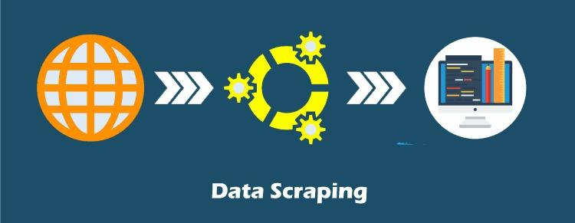
Data scraping using python
Guided by –
Prof. princy shrivastava

Slide 3




TEAM members
AKARSH SAXENA
(0105CB201004)
DEVENDRA PAWAR
(0105CB201014)
ISHU YADAV
(0105CB201022)

Slide 4
PRESENTATION OUTLINES
Introduction : Data Scraping.
Objective.
Technologies Used.
1. Python 2. Excel 3. Power BI
UML Diagram.
1. Data Flow 2. Use Case 3. Activity
Program.
Future Updates.

Slide 5
introduction : DATA SCRAPING
Data scraping allows you to acquire non-tabular or poorly structured data from websites and convert it into a usable, structured format, such as a .csv file or spreadsheet.
Scraping is about more than just acquiring data: it can also help you archive data and track changes to data online.

Slide 6
OBJECTIVE
To built a basic program to extract a data set with some specific information provided by the clients according to their needs.
And to analyse the extracted data set and check the most possible outcomes.

Slide 7

TECHNOLOGIES USED
PYTHON :
Python is a very popular general-purpose interpreted, interactive, object-oriented, and high-level programming language.
LIBRARIES USED :
Request
Beautiful Soup
Writer
Pandas

Slide 8


EXCEL :
Excel is a spreadsheet program from Microsoft and a component of its Office product group for business applications. It is also used for Data Cleaning.
POWER BI :
Power BI is an interactive data visualization software product developed by Microsoft with a primary focus on business intelligence. It is part of the Microsoft Power Platform.

Slide 9
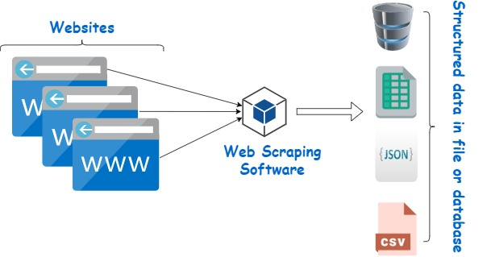
Diagram

Slide 10
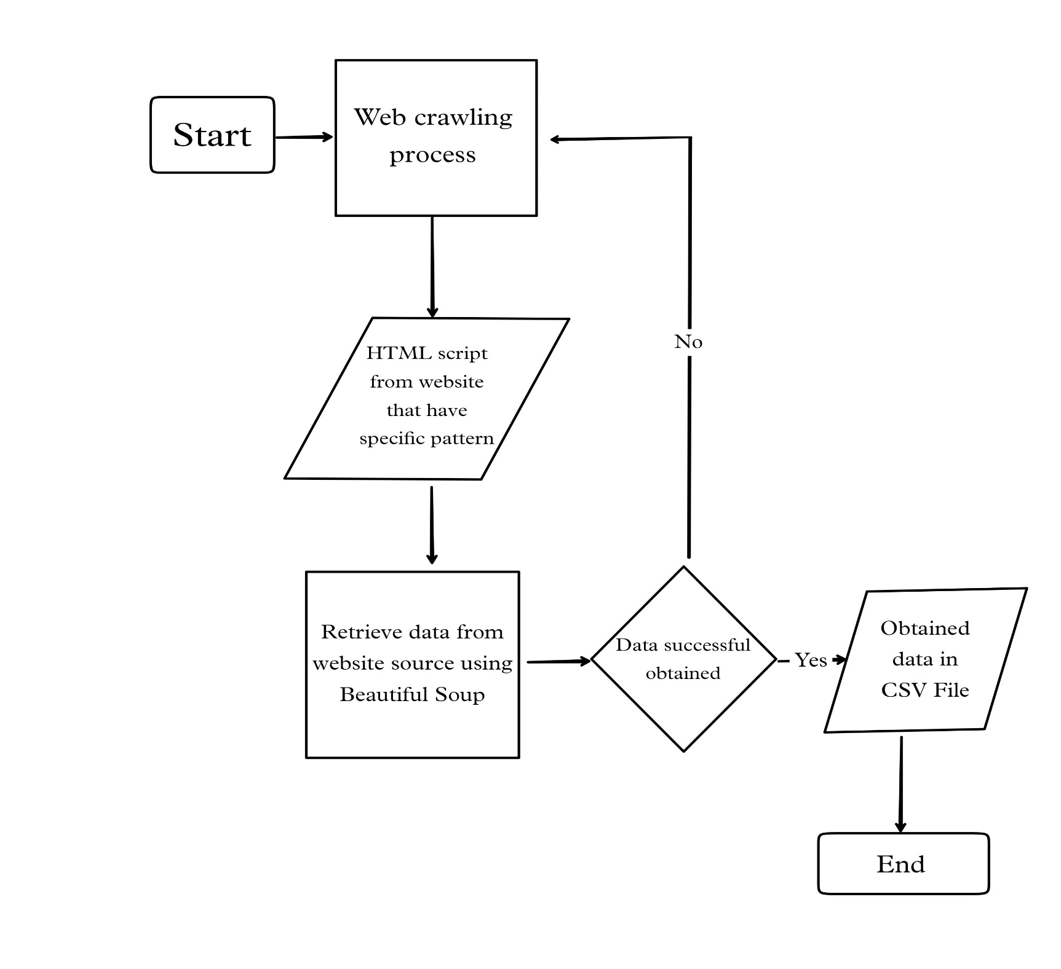
Dataflow diagram

Slide 11
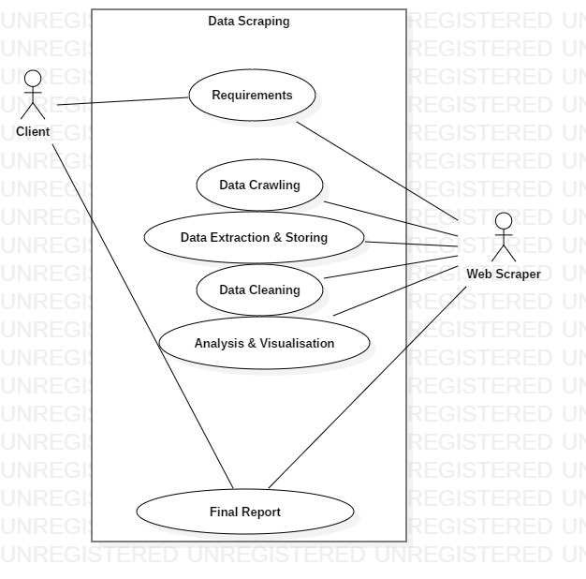
USECASE DIAGRAM

Slide 12
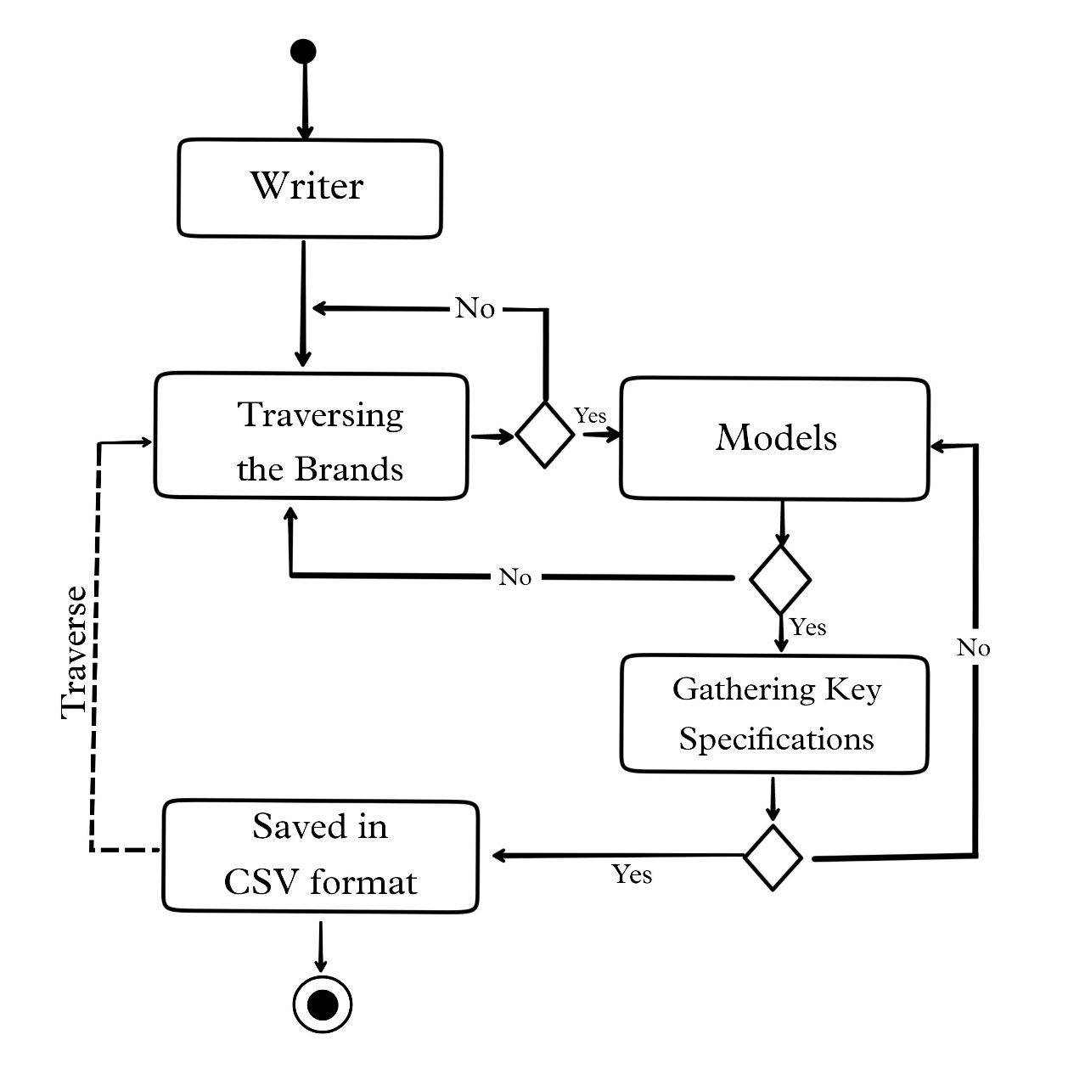
ACTIVITY DIAGRAM

Slide 13
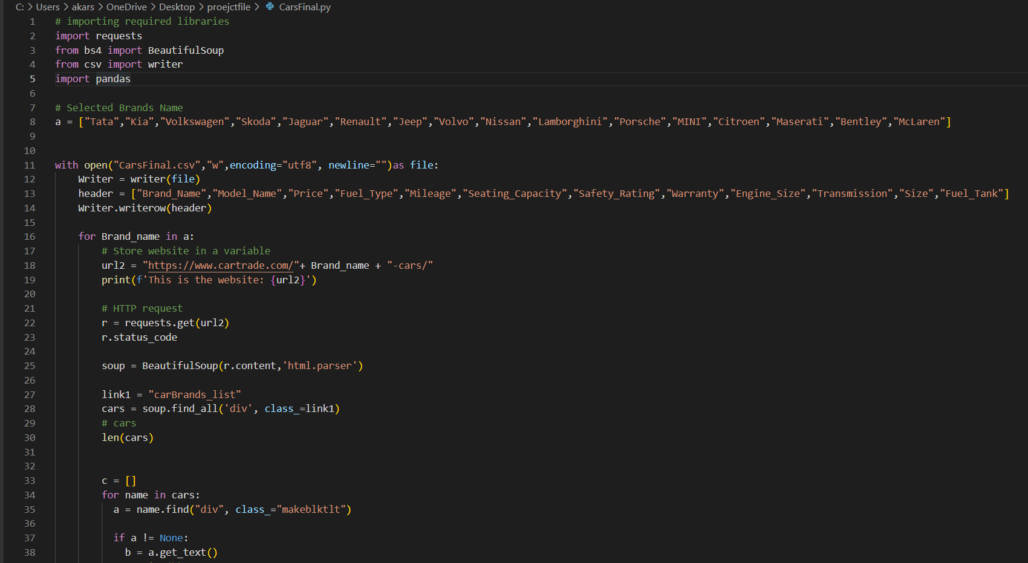

Slide 14
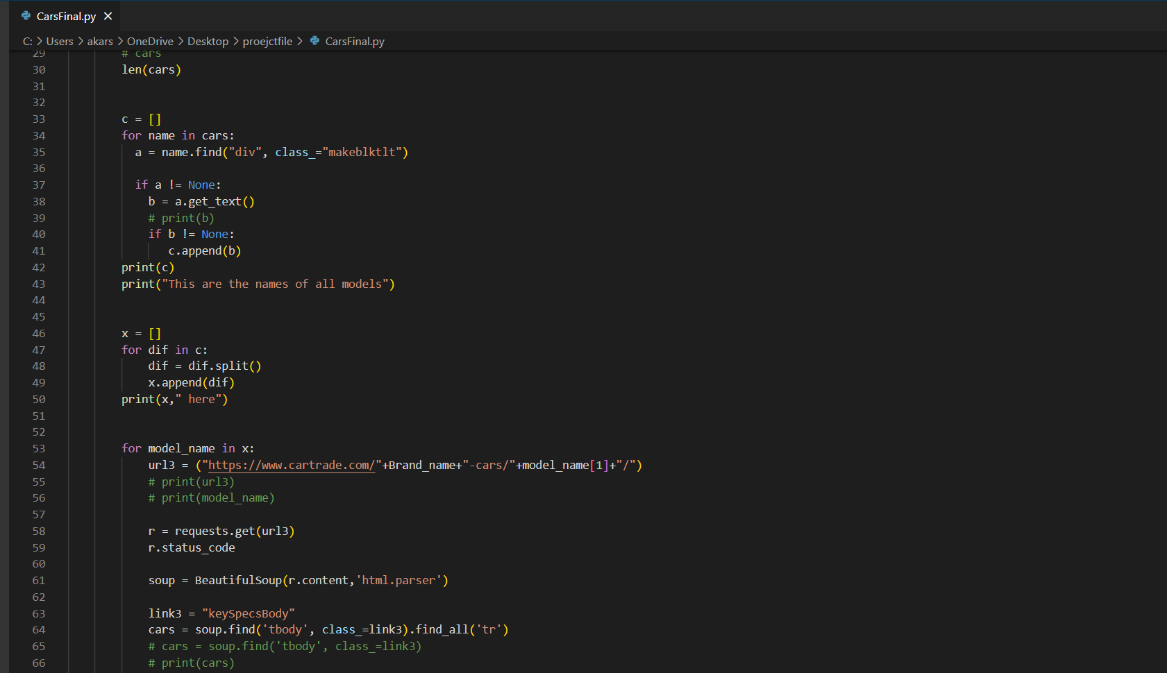

Slide 15
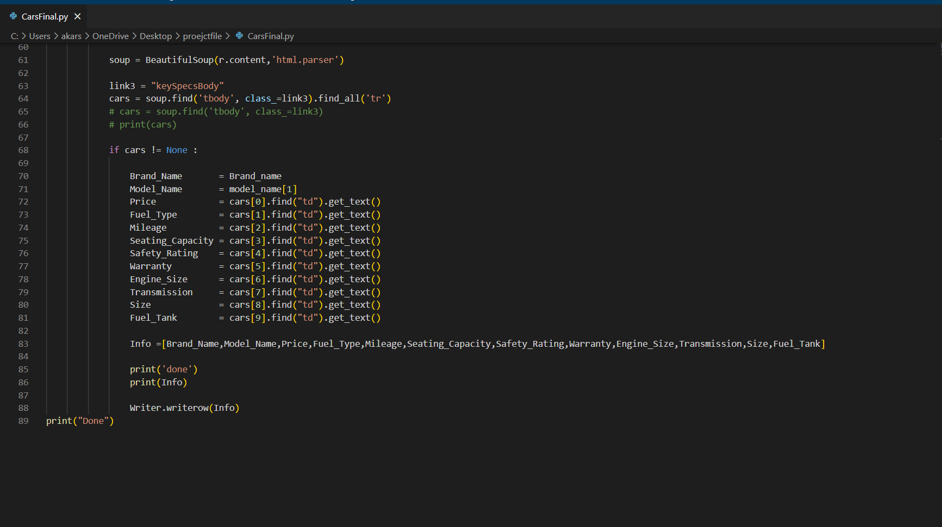

Slide 16
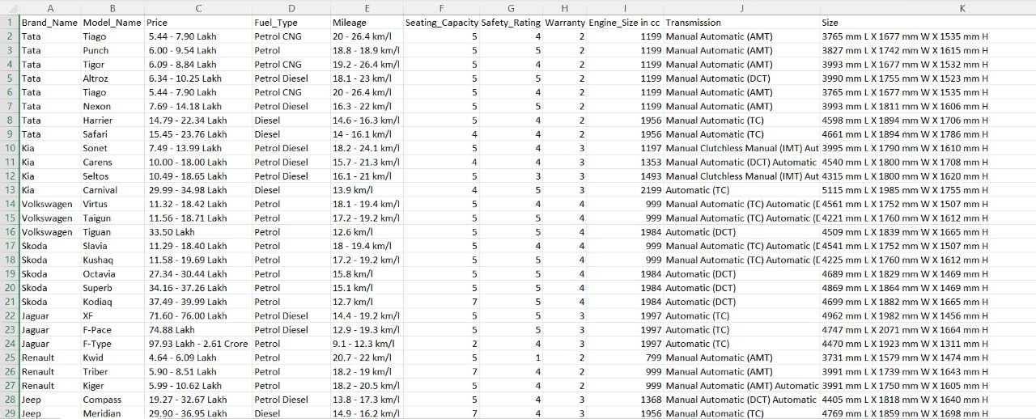
Cleaned excel dataset

Slide 17
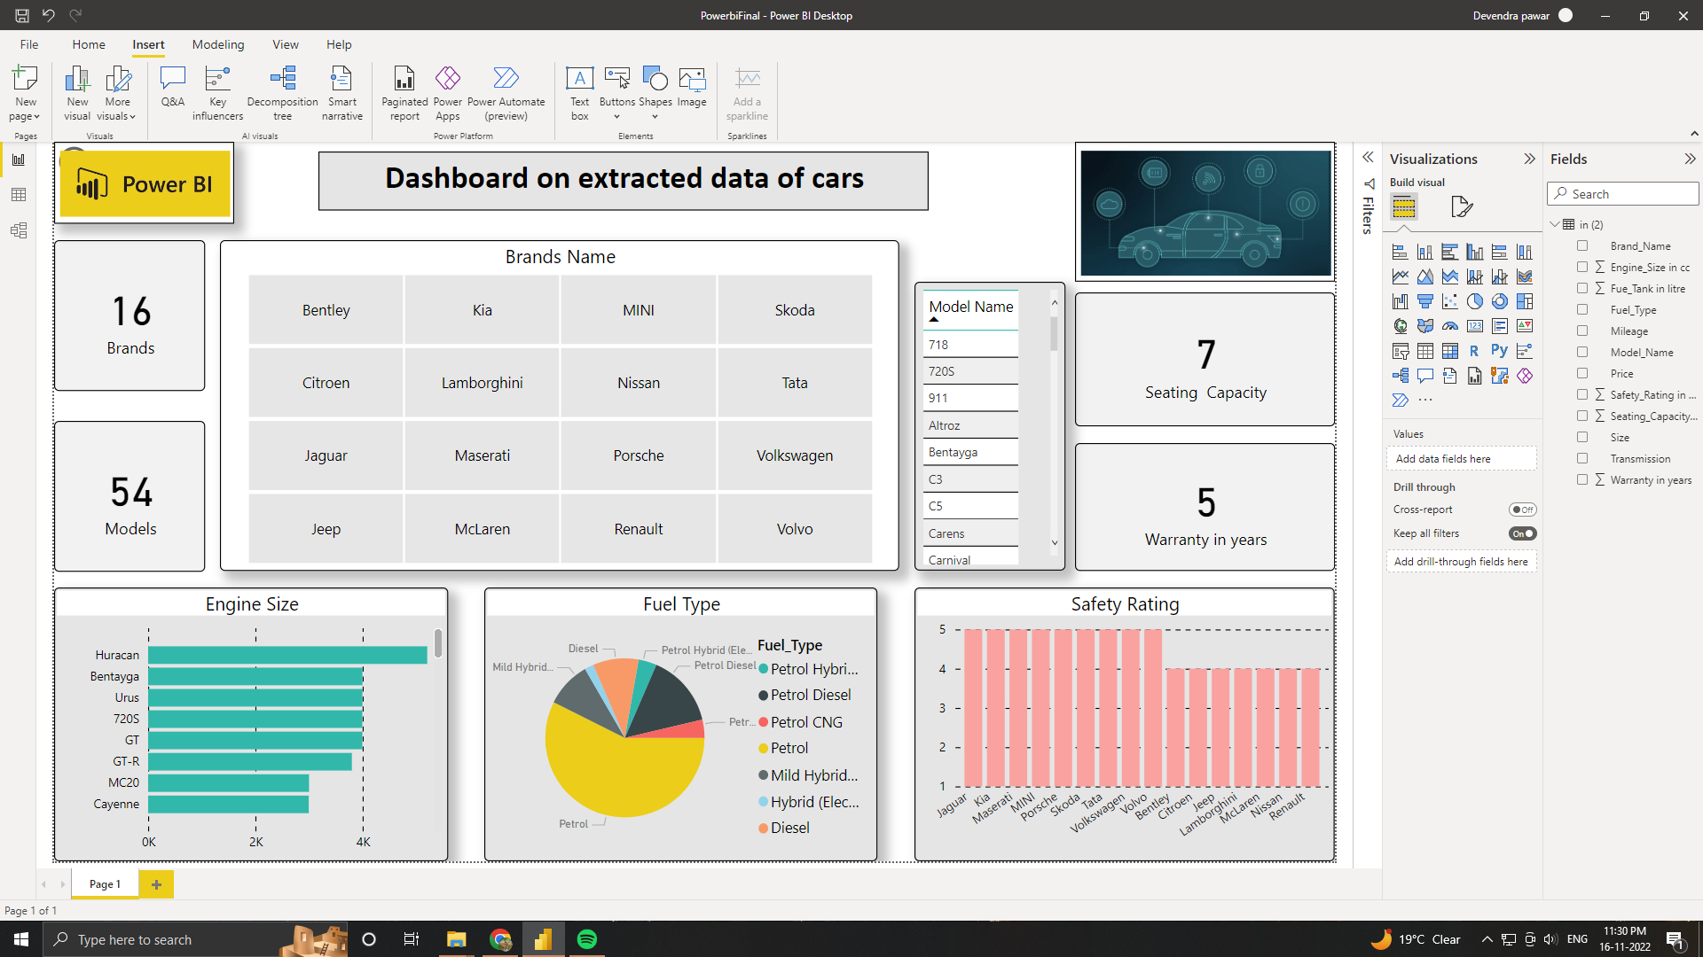
Dashboard

Slide 18
Future updates
More number of data sets could be extracted in future.
Can illustrate via graphics in future.
Can work on over-all optimization.

Slide 19
Thank you
Data Scraping Using Python

